Slide 1


ASHRAE GREAT ENERGY SAVER
Amit Kumar Yadav, Mahesh Latnekar and Prashil Negandhi

Slide 2

ASHRAE and The Kaggle Challenge
ASHRAE stands for American Society of Heating, Refrigerating and Air-Conditioning Engineers and it is an organization devoted to the advancement of indoor-environment-control technology in the heating, ventilation and air conditioning industry.
In this Kaggle competition, we had to accurately model the metered building energy usage in the following areas: chilled water, electric, hot water, and steam meters. However, for the purpose of this project, we just modeled electricity usage.
With better estimates of these energy-saving investments, large scale investors and financial institutions will be more inclined to invest in this area to enable progress in building efficiencies.

Slide 3
Dataset Description
Train Data:
building_id - Foreign key for the building metadata
meter - 0: electricity, 1: chilled water, 2: steam, 3: hotwater
timestamp - the time of measurement
meter_reading - Energy consumption in kWh (or equivalent)
Building Metadata:
site_id - Foreign key for the weather files
building_id - Foreign key for training.csv
primary_use - Indicator of the primary use of the building
square_feet - Gross floor area of the building
year_built - Year building was opened
floor_count - Number of floors of the building
Weather Data: Weather data from a meteorological station as close as possible to the site.
site_id
air_temperature - Degrees Celsius
cloud_coverage - Portion of the sky covered in clouds
dew_temperature - Degrees Celsius
precip_depth_1_hr - Millimeters
sea_level_pressure - Millibar/hectopascals
wind_direction - Compass direction (0-360)
wind_speed - Meters per second

Slide 4
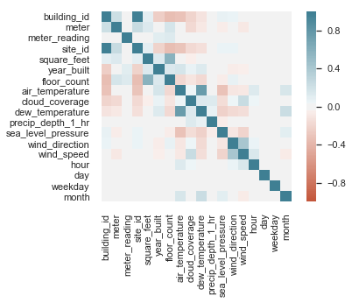
Correlation Matrix

Slide 5
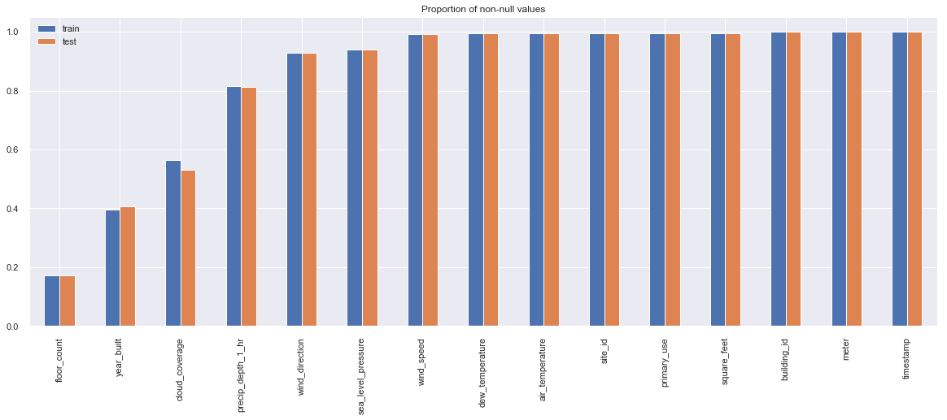
Non-Null Values in Dataset

Slide 6
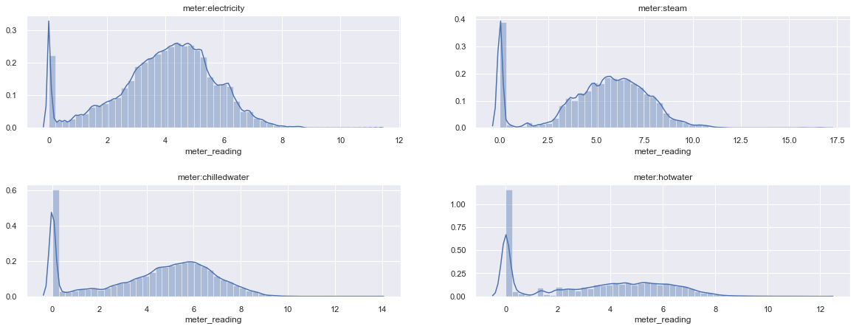
Meter Readings

Slide 7
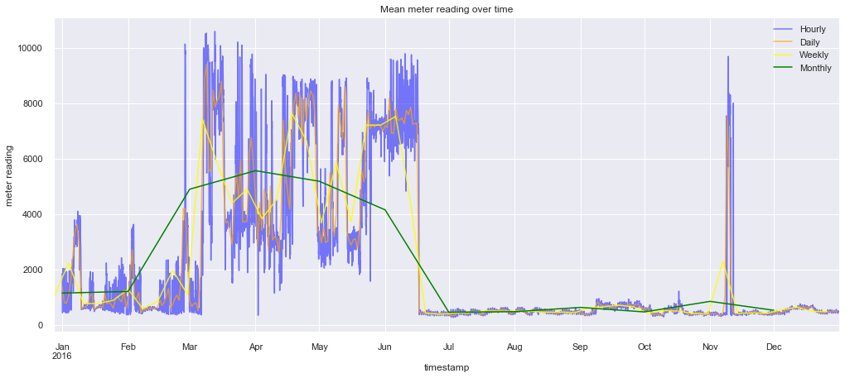
Mean meter reading over time

Slide 8
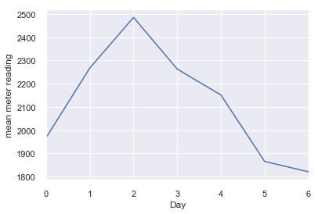
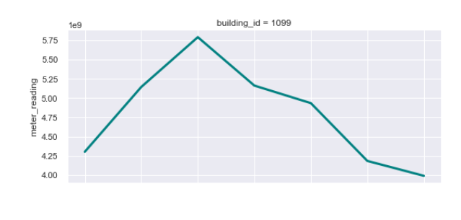
Mean meter reading over a week
We noticed an unexpected surge for day 2, so we dug deeper.
We found that just one building in the Education section was causing this behaviour.

Slide 9
Data Modeling
For this project, we are just considering the meter reading of electricity meter due to high volume of data. We are going to do a three step analysis:
We will try to see the effect of building configuration/metadata on meter reading.
We will incorporate weather and time information and see how these variables, along with the building metadata, affect meter reading
We will try some complicated model, LightGBM, and see how it fares with the previous simple linear models

Slide 10
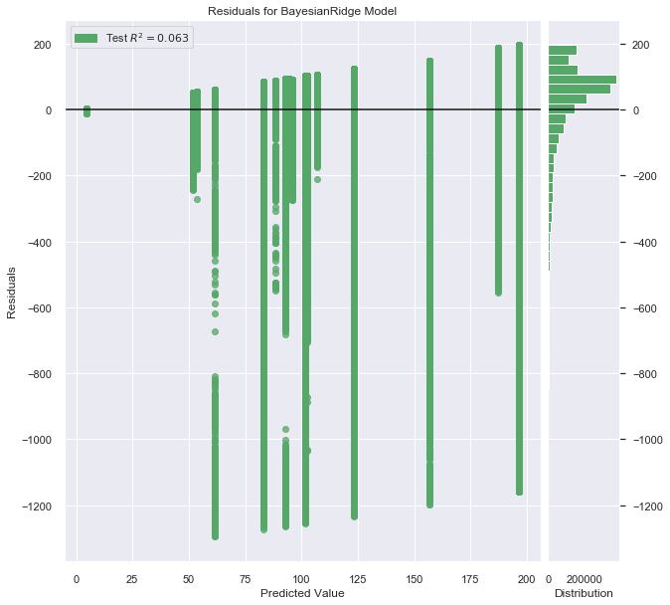
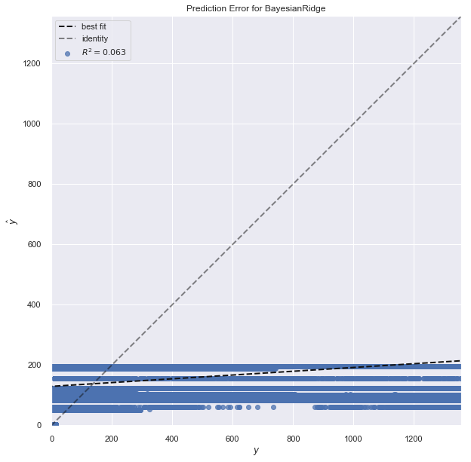
Impact of primary use on meter reading

Slide 11
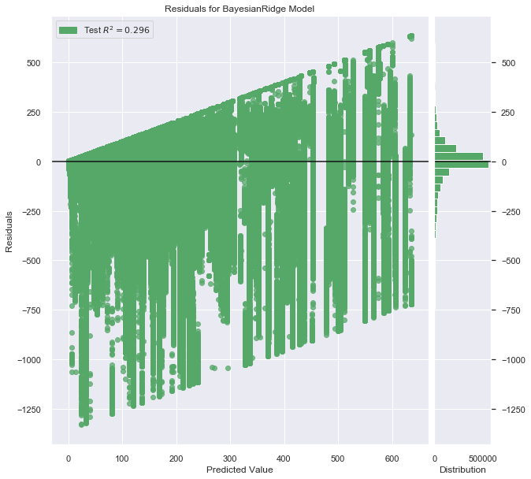
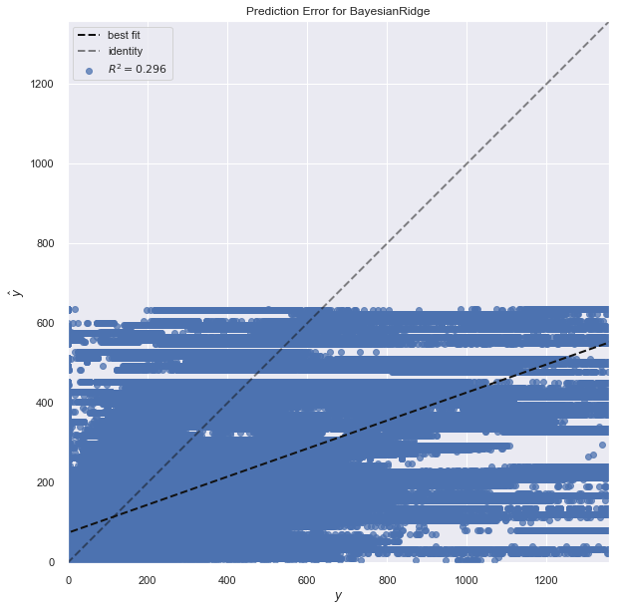
Impact of square_feet on meter reading

Slide 12
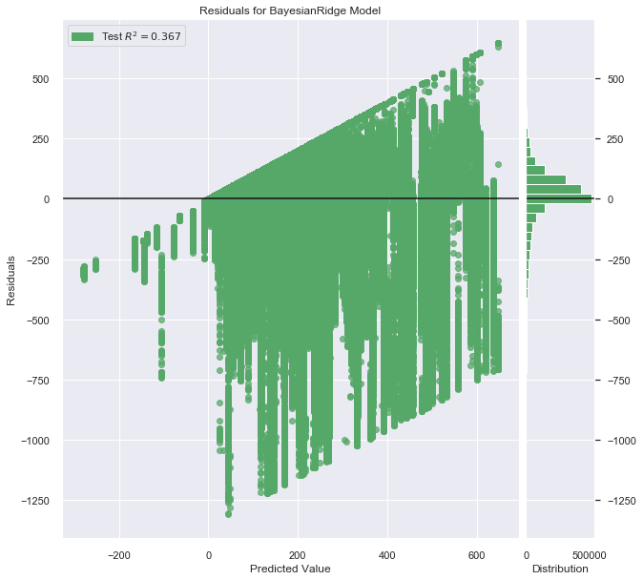
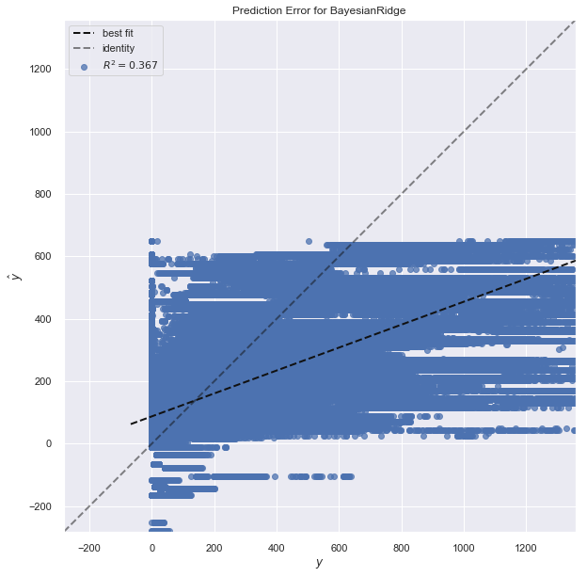
Using primary use & square-feet (without interaction)

Slide 13
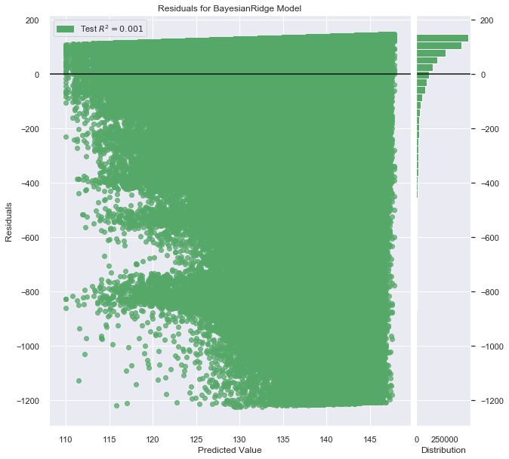
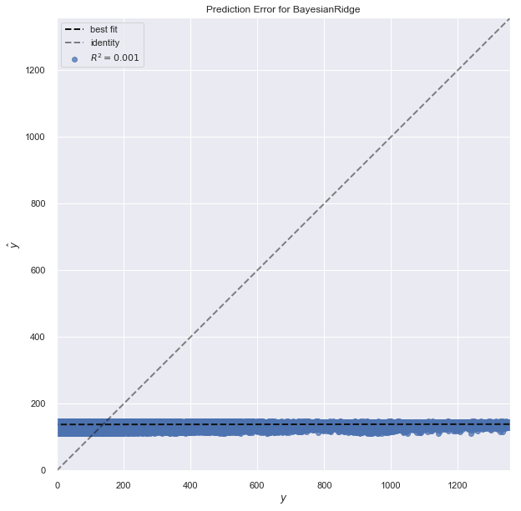
Using all weather variables

Slide 14
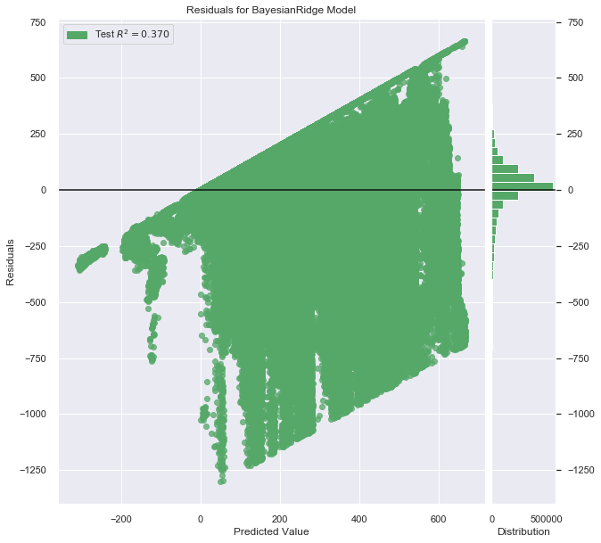
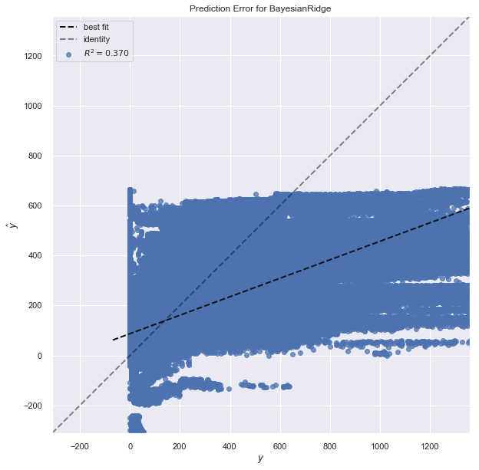
Using both building and weather variables

Slide 15
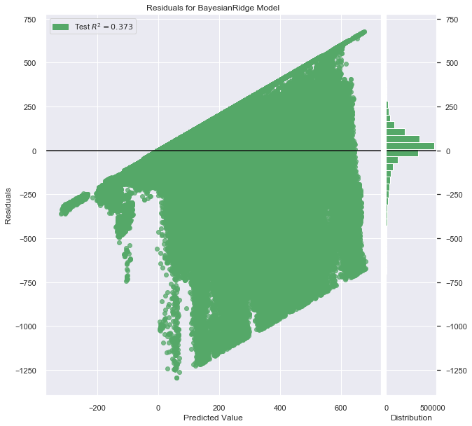
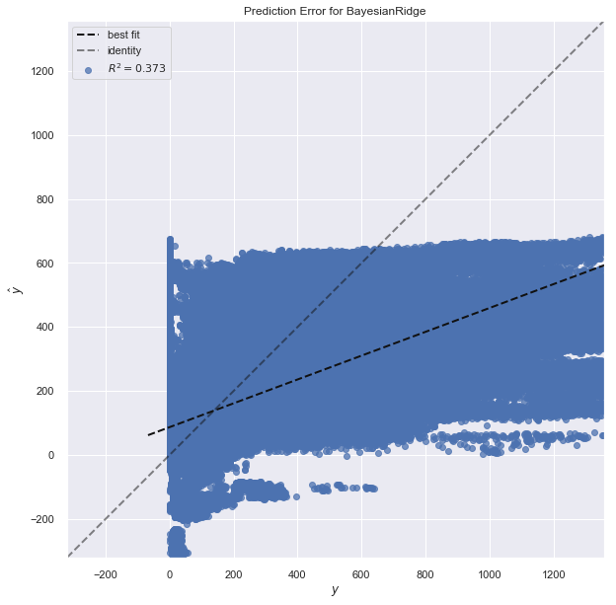
Adding time variables - day, month and is_holiday

Slide 16
Conclusion
We concluded that due to the complex nature of the dataset, using a simple model wouldn’t work. We would need to use a far more complex model to be better able to predict meter readings of electricity for all the buildings.
We also found that adding weather data onto the building metadata made the model predictions a bit better. However, we were not able to effectively add the time variables into our simple model.

Slide 17



Good luck!
We hope you’ll use these tips to go out and deliver a memorable pitch for your product or service!
For more (free) presentation tips relevant to other types of messages, go to heathbrothers.com/presentations
For more about making your ideas stick with others, check out our book!

